Slide 1
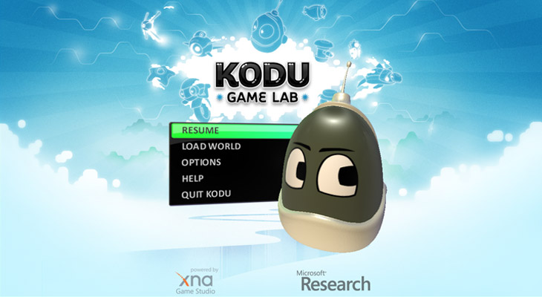

Slide 2


Overview
Kodu (originally named Boku) is a programming environment designed to be accessible for children and enjoyable for anyone.
Kodu runs on Microsoft Windows and the Xbox 360. It was released on the Xbox LIVE Marketplace on June 30, 2009.
A PC version is also available to academic users via invitation from Connect or from http://fuse.microsoft.com/kodu/

Slide 3
Key Features
Kodu provides an end-to-end creative environment for designing, building, and playing your own new games.
High-level language incorporates real-world primitives: collision, color, vision
Uses Xbox 360 Game Controller for input — no keyboard required
Runs on XBox 360 and PC (mouse, keyboard)
Interactive terrain editor
Bridge and path builder
Terrain editor - create worlds of arbitrary shape and size
20 different characters with different abilities

Slide 4
DEMO

